Slide 1
VISION TRANSFORMER FOR IMAGE CLASSIFICATION
By: Florin Camara & Pau Taló López

Slide 2
GOAL OF THE PROJECT
Compare the performance of a traditional Convolutional Neural Networks (CNN) with the Vision Transformer (ViT) model for image classification.

Slide 3


TOOLS USED IN THIS PROJECT
Dataset from Kaggle named: “7000 Labeled Pokémon” which we divided into Train and Test folders.
An already implemented Pokémon classifier using a CNN model.
Google Colaboratory to implement the code and run it with a remote GPU.

Slide 4

WHAT IS IMAGE CLASSIFICATION?
Neural
Network
Dog

Slide 5
WHAT IS IMAGE CLASSIFICATION?
Neural
Network
Output P

Slide 6







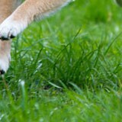

HOW DOES A ViT WORK?
Split Image into Patches
Patches can overlap and have the same shape
User specifies:
Patch size
Stride

Slide 7
HOW DOES A ViT WORK?
Split Image into Patches
Patches can overlap and have the same shape
User specifies:
Patch size
Stride

Slide 8
HOW DOES A ViT WORK?
Split Image into Patches
Patches can overlap and have the same shape
User specifies:
Patch size
Stride

Slide 9
HOW DOES A ViT WORK?
Split Image into Patches
Patches can overlap and have the same shape
User specifies:
Patch size
Stride

Slide 10
HOW DOES A ViT WORK?
Patches Vectorization
Every patch is a image with RGB channels and an order 3 tensor.
A tensor is a generalization of vectors and matrices (multidimensional array)

Slide 11









VECTORIZATION
If the patches are $d_{1}xd_{2}xd_{3}$ tensors, then the vectos are $d_{1}d_{2}d_{3}x1.$
$$X_{1}$$
$$X_{2}$$
$$X_{3}$$
$$X_{4}$$
$$X_{5}$$
$$X_{6}$$
$$X_{7}$$
$$X_{8}$$
$$X_{9}$$

Slide 12





NEURAL NETWORK
$$Z_{1}=W·X_{1}+b$$
Dense
$$X_{1}$$
$$X_{2}$$
$$X_{3}$$
. . .
$$X_{n}$$

Slide 13





NEURAL NETWORK
$$Z_{1}$$
$$Z_{2}$$
$$Z_{3}$$
$$Z_{n}$$
Dense
Dense
Dense
. . .
Dense
Share parameters
$W$ & $b$
$$X_{1}$$
$$X_{2}$$
$$X_{3}$$
$$X_{n}$$

Slide 14







POSITIONAL ENCODING
$$1$$
$$2$$
$$3$$
n
Positional
Encoding
. . .
$$Z_{1}$$
$$Z_{2}$$
$$Z_{3}$$
. . .
$$Z_{n}$$

Slide 15

POSITIONAL ENCODING
Add positional encoding vectors to $Z_{1}$, $Z_{2}$, …, $Z_{n}$
$$Z_{1}$$
$$Z_{2}$$
$$Z_{3}$$
. . .
$$Z_{n}$$

Slide 16
WHY POSITIONAL ENCODING?

Slide 17
WHY POSITIONAL ENCODING?
1
2
3
4
5
6
7
8
9

Slide 18

COLLECTIVE LEARNING SYSTEM TOKEN
$$Z_{0}$$
$$Z_{1}$$
$$Z_{2}$$
$$Z_{3}$$
$$Z_{n}$$
Embed
Dense
Dense
Dense
. . .
Dense
[CLS]
$$X_{1}$$
$$X_{2}$$
$$X_{3}$$
$$X_{n}$$

Slide 19









MULTI-HEAD SELF-ATTENTION LAYER
Multi-Head Self-Attention
$$Z_{0}$$
$$Z_{1}$$
$$Z_{2}$$
$$Z_{3}$$
$$Z_{n}$$
Embed
Dense
Dense
Dense
. . .
Dense
[CLS]
$$X_{1}$$
$$X_{2}$$
$$X_{3}$$
$$X_{n}$$

Slide 20
WHAT IS SELF-ATTENTION?
Say we want to translate the following input sentence: “The animal didn’t cross the street because it was too tired”
What does “it” refer to?
When the model processes each word, self attention allows it to look at other positions in the input for clues that can help lead to a better encoding for this word

Slide 21
TRANSFORMER ENCODER NETWORK
}
Dense
Transformer
Encoder
Network
Multi-Head Self-Attention
$$Z_{0}$$
$$Z_{1}$$
$$Z_{2}$$
$$Z_{3}$$
$$Z_{n}$$
Embed
Dense
Dense
Dense
. . .
Dense
[CLS]
$$X_{1}$$
$$X_{2}$$
$$X_{3}$$
$$X_{n}$$

Slide 22





TRANSFORMER ENCODER NETWORK
$$C_{0}$$
$$C_{1}$$
$$C_{2}$$
$$C_{3}$$
. . .
$$C_{n}$$
Multi-Head Self-Attention
$$Z_{0}$$
$$Z_{1}$$
$$Z_{2}$$
$$Z_{3}$$
$$Z_{n}$$
Embed
Dense
Dense
Dense
. . .
Dense
[CLS]
$$X_{1}$$
$$X_{2}$$
$$X_{3}$$
$$X_{n}$$

Slide 23
TRANSFORMER ENCODER NETWORK
Softmax
Classifier
$$C_{0}$$
Output P
Multi-Head Self-Attention
$$Z_{0}$$
$$Z_{1}$$
$$Z_{2}$$
$$Z_{3}$$
$$Z_{n}$$
Embed
Dense
Dense
Dense
. . .
Dense
[CLS]
$$X_{1}$$
$$X_{2}$$
$$X_{3}$$
$$X_{n}$$

Slide 24
TRANSFORMER ENCODER NETWORK
Softmax
Classifier
$$C_{0}$$
Output P

Slide 25

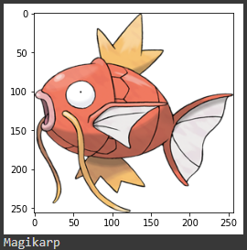
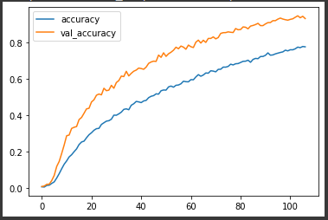
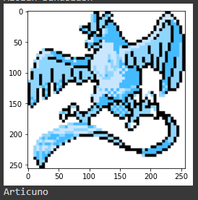
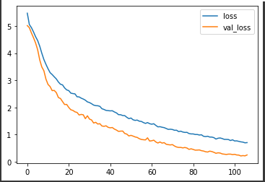
RESULTS

Slide 26
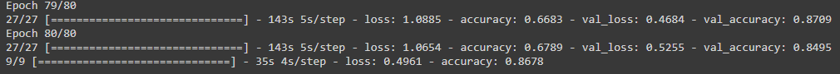

CONCLUSIONS
ViT version of the Pokémon classifier has better accuracy than the CNN version
ViT accurancy
CNN accurancy

Slide 27

















CONCLUSIONS
How to improve ViT’s performance
Randomly initialized
Pretrained
Fine-tuned
Test Accuracy
Dataset A
Training set of Dataset B
Test set of Dataset B

Slide 28
CONCLUSIONS
ViT compared to ResNet on image classification accuracies
ResNet is better
ViT is better
Number of images
for pretraining
100M images
300M images

Slide 29
CONCLUSIONS
Pretrained on ImageNet (small), ViT is slightly worse than ResNet.
Pretrained on ImageNet-21K (medium), ViT is comparable to ResNet.
Pretrained on JFT (large), ViT is slightly better than ResNet.
Dataset | # of Images | # of Classes
ImageNet | 1,3 Million | 1 Thousand
ImageNet-21K | 14 Million | 21 Thousand
JFT | 300 Million | 18 Thousand

Slide 30
BIBLIOGRAPHY
Image Classification with Vision Transformer:
https://keras.io/examples/vision/image_classification_with_vision_transformer/
Vision Transformer for Image Classification - Shusen Wang:
https://www.youtube.com/watch?v=HZ4j_U3FC94
An image is worth 16x16 words: Transformers for image recognition at scale - Alexey Dosovitskiy:
https://arxiv.org/pdf/2010.11929.pdf
Vision Transformer (ViT):
https://huggingface.co/transformers/model_doc/vit.html#:~:text=A%20%5BCLS%5D%20token%20is%20added,can%20be%20used%20for%20classification.&text=As%20the%20Vision%20Transformer%20expects,normalize%20images%20for%20the%20model.
7,000 Labeled Pokemon - Lance Zhang:
https://www.kaggle.com/lantian773030/pokemonclassification
Pokemon Image Classifier - Dharmin Shah:
https://www.kaggle.com/dharminshah/pokemonclassifier/notebook
A CLS Hierarchy for the Classification of Images:
https://link.springer.com/chapter/10.1007/11579427_37#:~:text=The%20adaptive%20algorithm%20used%20in,%3A%20recognition%2C%20classification%20and%20segmentation.
The Illustrated Transformer - Jay Alammar:
https://jalammar.github.io/illustrated-transformer/
Softmax Activation Function with Python:
https://machinelearningmastery.com/softmax-activation-function-with-python/

Slide 31
VISION TRANSFORMER FOR IMAGE CLASSIFICATION
By: Florin Camara & Pau Taló López

